Slide 1
What Determines a Succesful Movie?
By
Chioma Udokwu

Slide 2
Project Description:
For this final project. I needed to analyze the IMDB movie dataset using a variety of machine learning models we have learned. With the hopes of figuring out what attributes makes a movie successful. Through the processes listed below
Regression: Build regression models using different regression algorithms. The Y value is imdb_score. It is important you use important features in your models.
Classification: The goal is to build a classification model to predict if a movie is good or bad. You need to create a new “categorical” column from imdb_score in order to build classification models. Create the column by “binning” the imdb_score into 4 categories
Clustering: Analyze the data using K-means algorithm and Hierarchical clustering algorithm. You determine the optimal K value for K-means.

Slide 3
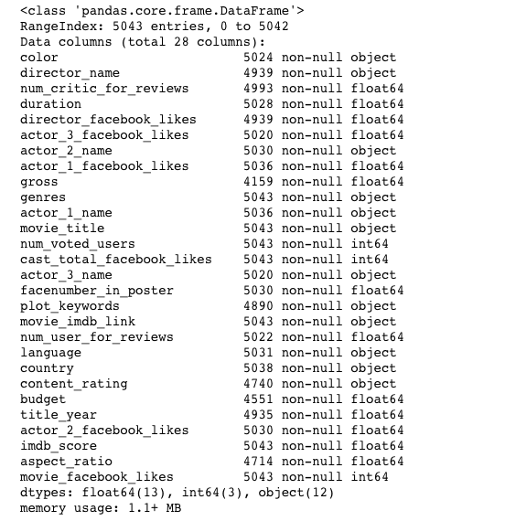
Introduction
In this presentation I will identify my analysis over the movie_metadata file. In this file we were given a lot of information with the hopes of cleaning it up to come up with a conclusive summary of what exactly makes a movie successful. The picture lo the right of this show the breakdown of the csv. file untouched .

Slide 4
Variables Consider important
Some of the variables that I believe to be important in determining if a movie is successful are as follow:
Number of critics for reviews
Duration
Gross
Genres
Number of voted users
Content ratings
Budget
Imdb score

Slide 5
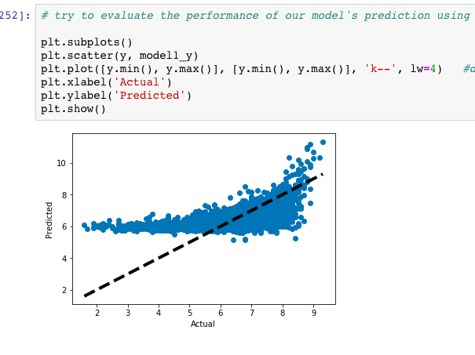
Regression Analysis
So with the regression Model we were able to predict the mean square error which was 0.8723374980744721. This means that are model that we used was really good because of how close it is to being 1.
As far as the Recursive Feature Selection the top features that help predict if a movie will be good is the duration and the number of faces in a particular poster.
The image to the right shows the performance of our model prediction

Slide 6
Classification Analysis
For the classification analysis we needed to create a categorical column that will help keep the imdb score in a specific category and ultimately make the data more clear for understanding and interpreting. With this specific analysis some of my key finding was that my models that I created were fairly weak in comparison to my regression model. The only model that was somewhat or was the decision tree model.

Slide 7
Classification Analysis continued…
Another thing that I noticed with this analysis is that whenever I tried to evaluate the models the same error message popped up. Which could be another factor as to why these models where so weak.

Slide 8
Clustering Analysis
from the cluster analysis we see that category group number 3 is the best option. We can tell this because it comes up the most. Also I did further analysis to see which cluster group was the largest and from the results it seem like cluster 0 is the largest coming in at 4105 cluster. which correlates with category 2.

Slide 9
Overall Conclusion for Analysis
Overall I believe the regression analysis was the best method in my case for predicting what attributes made a movie successful. It yield the highest score as well as made it easier to see what exact attributes went into making a movie successful.

Slide 10
Recommendation to movie producer
I recommend that producers do the following if they want to have a successful movie:
Make the duration of the movie reasonable and not to long
Have poster that shows the actors faces on it
Keep in mind some of the critics reviews and learn from past mistakes

Slide 11
Additional variables that would help with prediction…
Some additional variables that would have been helpful in predicting a movies successful
Advertisement ( amount spent)
Actual amount spent on the movie
Location where movie where shot
Critically acclaimed actors in the movies

Slide 12
Conclusion:
In conclusion the project was very insightful as far as predicating what would be successful. I only wish that some of the programs ran smoother in the process to give me the best possible results.

